Slide 1
Joining Forces: Data Merging Techniques in R
Amrom Obstfeld MD PhD

Slide 2
Session | Instructor
Database Concepts Demystified | Joe Rudolf, MD
Databases with R: A Marriage Made in the Tidyverse | Patrick Mathias, MD, PhD
Joining Forces: Data Merging Techniques in R | Amrom Obstfeld, MD, PhD
Getting Your Feet Wet with Clinical Research Data with REDCap and R | Stephan Kadauke, MD, PhD

Slide 3
Goal: Provide a clear understanding of the fundamental concepts of joins
Objectives:
Explain the purpose and importance of joins in data analysis.
Describe the mechanics of left joins and inner joins, highlighting their differences.
Demonstrate how to apply joins to solve real-world problems in a lab/healthcare setting.

Slide 4
HPI:
CAP is inspecting your lab and one of the inspectors asked your chair what your top performed test is.
Your chair surreptitiously texts you as he distracts the inspector with some free Nespresso……

Slide 5

Your Turn 1
Connect to the MIMIC IV database and answer:
Q: What the most commonly ordered lab test is in the database?

Slide 6
Overall analytic strategy
Read data from LABEVENTS table
Count the number of rows per ItemID
Arrange from large to smallest count
Top row is the winner!
Notes:
Should get ItemID 50971

Slide 7
labevents <- tbl(mimic, "labevents")
labevents |>
count(itemid) |>
arrange(desc(n))

Slide 8
What is itemid 50971?
Notes:
Audience suggests ways to figure this out

Slide 9
Itemid 50971- Analytic Strategy
1. Find 50971 in the View pane for of D_LABITEMS
2. Read D_LABITEMS |> filter itemid==50971

Slide 10
Your Turn 1b
Connect to the MIMIC IV database and answer:
Q: What the most commonly ordered lab test is in the database?
A: Potassium!
Q: What are the top 100 ordered lab tests?

Slide 11
Joins
Notes:
I'm here just to give you a quick introduction after which we'll dive right into the meat of the workshop.

Slide 12
 | LABEVENTS
1 Row for each lab ordered test
 | D_LABITEMS
1 Row for each type of lab order

Slide 13
xxxx_join()
ItemID | Count
50971 | 3022
50983 | 3007
50912 | 3003
50902 | 2981
51006 | 2974
ItemID | label
50902 | Chloride
50912 | Creatinine
50971 | Potassium
50983 | Sodium
51006 | Urea Nitrogen
ItemID | Count | label
50971 | 3022 | Potassium
50983 | 3007 | Potassium
50912 | 3003 | Sodium
50902 | 2981 | Chloride
51006 | 2974 | Urea Nitrogen

Slide 14
xxxx_join()
ItemID | Count
50971 | 3022
50983 | 3007
50912 | 3003
50902 | 2981
51006 | 2974
ItemID | label
50902 | Chloride
50912 | Creatinine
50971 | Potassium
50983 | Sodium
51006 | Urea Nitrogen
ItemID | Count | label
50971 | 3022 | Potassium
50983 | 3007 | Sodium
50912 | 3003 | Sodium
50902 | 2981 | Chloride
51006 | 2974 | Urea Nitrogen

Slide 15
xxxx_join()
ItemID | Count
50971 | 3022
50983 | 3007
50912 | 3003
50902 | 2981
51006 | 2974
ItemID | label
50902 | Chloride
50912 | Creatinine
50971 | Potassium
50983 | Sodium
51006 | Urea Nitrogen
ItemID | Count | label
50971 | 3022 | Potassium
50983 | 3007 | Sodium
50912 | 3003 | Creatinine
50902 | 2981 | Chloride
51006 | 2974 | Urea Nitrogen

Slide 16
xxxx_join()
ItemID | Count
50971 | 3022
50983 | 3007
50912 | 3003
50902 | 2981
51006 | 2974
ItemID | label
50902 | Chloride
50912 | Creatinine
50971 | Potassium
50983 | Sodium
51006 | Urea Nitrogen
ItemID | Count | label
50971 | 3022 | Potassium
50983 | 3007 | Sodium
50912 | 3003 | Creatinine
50902 | 2981 | Chloride
51006 | 2974 | Urea Nitrogen

Slide 17
xxxx_join()
ItemID | Count
50971 | 3022
50983 | 3007
50912 | 3003
50902 | 2981
51006 | 2974
ItemID | label
50902 | Chloride
50912 | Creatinine
50971 | Potassium
50983 | Sodium
51006 | Urea Nitrogen
ItemID | Count | label
50971 | 3022 | Potassium
50983 | 3007 | Sodium
50912 | 3003 | Creatinine
50902 | 2981 | Chloride
51006 | 2974 | Urea Nitrogen

Slide 18
xxxx_join()
3. A shared column
Merge two data frames based on columns(s)
2. Another data frame
1. A data frame
xxxx_join(df1, df2, join_by(shared_column))

Slide 19
Joins in R
Which rows you want in the result
Which columns you want in the result
The criteria for matching rows
left_join()
semi_join()
inner_join()
anti_join()
right_join()
cross_join()
full_join()
…

Slide 20
Joins in R
Which rows you want in the result
Which columns you want in the result
The criteria for matching rows
Which rows you want in the result
left_join()
semi_join()
inner_join()
anti_join()
right_join()
cross_join()
full_join()
…

Slide 21

inner_join()

Slide 22
inner_join()
An inner join:
Retains only rows that match in both tables.
Excludes rows without matches in both tables.
Combines columns from both tables.

Slide 23
inner_join()
ItemID | label
50902 | Creatinine
50912 | Potassium
50971 | Sodium
50809 | Glucose

Slide 24
inner_join()
2. Another data frame
1. A data frame
3. A shared column
left_join(df1,df2,join_by(shared_column))
ItemID | label
50902 | Creatinine
50912 | Potassium
50971 | Sodium
50809 | Glucose

Slide 25
inner_join()
inner_join(LABEVENTS,D_LABITEMS,join_by(itemid))
ItemID | Count
50902 | 2981
ItemID | label
50902 | Creatinine
50912 | 3003
50912 | Potassium
50971 | 3022
50971 | Sodium
ItemID | label
50902 | Creatinine
50912 | Potassium
50971 | Sodium
50809 | Glucose

Slide 26
Your Turn 2
Starting with labevents, join to the d_labitems table
Find the number of times each lab order was placed

Slide 27
labevents_n <- labevents |>
inner_join(d_labitems, join_by(itemid)) |>
count(itemid, label) |>
arrange(desc(n))

Slide 28
Question
Examine the original LABEVENTS table
How many distinct ItemIDs does it have?
Examine the table you produced
How many distinct ItemIDs does it have?
498
496

Slide 29
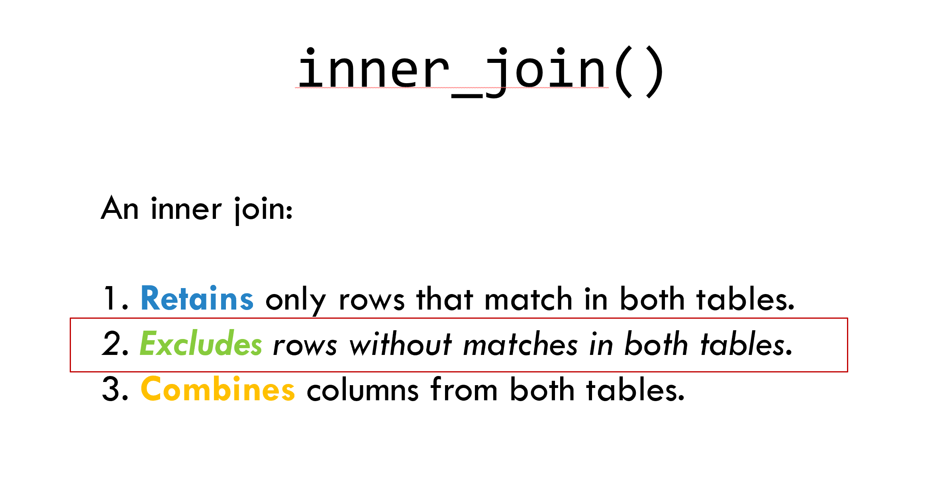
inner_join()
inner_join(LABEVENTS,D_LABITEMS,join_by(itemid))
ItemID | Count
50902 | 2981
ItemID | label
50902 | Creatinine
50912 | 3003
50912 | Potassium
50971 | 3022
50971 | Sodium
50983 | 3007
50809 | Glucose
51006 | 2974
ItemID | label
50902 | Creatinine
50912 | Potassium
50971 | Sodium
50809 | Glucose

Slide 30
inner_join()
An inner join:
Retains only rows that match in both tables.
Excludes rows without matches in both tables.
Combines columns from both tables.

Slide 31
left_join()
Notes:
We will start with the select function. It’s not uncommon to get datasets with hundreds or even thousands of columns. In this case, the first challenge is often focusing in on the variables you’re actually interested in. select() allows you to rapidly zoom in on a useful subset of the columns in the raw data.

Slide 32
left_join()
A left join:
Retains every row from the left table.
Includes only matching rows from the right table.
Combines columns from both tables.
ItemID | label
50902 | Creatinine
50912 | Potassium
50971 | Sodium
50809 | Glucose

Slide 33
left_join()
ItemID | label
50902 | Creatinine
50912 | Potassium
50971 | Sodium
50809 | Glucose

Slide 34
left_join()
2. Another data frame
1. A data frame
3. A shared column
left_join(LABEVENTS,D_LABITEMS,join_by(itemid))
ItemID | value
50902 | 97
50912 | 2.6
50971 | 4.3
50983 | 141
51006 | 32
ItemID | label
50902 | Chloride
50912 | Creatinine
50971 | Potassium
NA | NA
50809 | Glucose
50809 | Glucose
NA | NA
ItemID | label
50902 | Creatinine
50912 | Potassium
50971 | Sodium
50809 | Glucose

Slide 35
left_join()
left_join(LABEVENTS,D_LABITEMS,join_by(itemid))
ItemID | value
50902 | 97
50912 | 2.6
50971 | 4.3
50983 | 141
51006 | 32
ItemID | label
50902 | Chloride
50912 | Creatinine
50971 | Potassium
NA | NA
50809 | Glucose
NA | NA
ItemID | label
50902 | Creatinine
50912 | Potassium
50971 | Sodium
50809 | Glucose

Slide 36
Your Turn 3
Only one patient had a bleeding time (ItemID 51149)
Using a left join find this patients gender and age by filtering the LABEVENTS table and joining to the PATIENTS table
Notes:
Make it so that not everyone in the patient table has a lab order

Slide 37
labevents |>
filter(itemid == 51149) |>
left_join(patients, join_by(subject_id)) |>
select(gender, anchor_age)

Slide 38
Cartesian Products

Slide 39
HPI:
You, the hematology laboratory director, are listening in on Hematology Grand Rounds while quietly shopping on Amazon.
During a discussion about thrombotic thrombocytopenic purpura, the Hematology Division Chief asks you if you knew what diagnoses patients with schistocytes on their blood smear have…

Slide 40
Overall analytic strategy
Read
Connect to LABEVENTS, D_LABITEMS, DIAGNOSES_ICD tables
Join
Join LABEVENTS to D_LABITEMS table
Filter
Filter to patients positive for Schistocytes
Join
Join to DIAGNOSES_ICD table!
Notes:
Should get ItemID 50971

Slide 41
Your Turn 4
Using this analytic strategy create a table containing the ICD codes associated with patients with schistocytes.
Connect to LABEVENTS, D_LABITEMS, DIAGNOSES_ICD tables
Inner Join LABEVENTS to D_LABITEMS table
Filter to patients positive for "Schistocytes"
HINT: The Schistocytes component is only reported when schistocytes are present.
Join to DIAGNOSES_ICD table

Slide 42
labevents |>
left_join(d_labitems,join_by(itemid)) |>
filter(label == "Schistocytes") |>
inner_join(diagnoses_icd, join_by(subject_id))

Slide 43
Question
Examine the diagnoses for the first patient (subject_id 10035631) ?
Is this expected?

Slide 44
Question
Can a patient have multiple Schistocyte results?
Can a patient have multiple diagnostic codes?

Slide 45
inner_join()
inner_join(LABS, DIAGNOSES_ICD, join_by(subject_id))
index | subject_id | comments
1 | 10003400 | OCCASIONAL
subject_id | icd_code
10003400 | V161
10003400 | V161
10003400 | V161
2 | 10003400 | 2+
1 | 10003400 | OCCASIONAL
10003400 | E9352
10003400 | E9352
10003400 | E9352
3 | 10003400 | 1+
3 | 10003400 | 1+
2 | 10003400 | 2+

Slide 46
inner_join()
inner_join(LABS, DIAGNOSES_ICD, join_by(subject_id))
index | subject_id | comments
1 | 10003400 | OCCASIONAL
subject_id | icd_code
10003400 | V161
10003400 | V161
10003400 | V161
1 | 10003400 | OCCASIONAL
10003400 | E9352
10003400 | E9352
10003400 | E9352
2 | 10003400 | 2+
3 | 10003400 | 1+
3 | 10003400 | 1+
2 | 10003400 | 2+

Slide 47
inner_join()
inner_join(LABS, DIAGNOSES_ICD, join_by(subject_id))
index | subject_id | comments
1 | 10003400 | OCCASIONAL
subject_id | icd_code
10003400 | V161
10003400 | V161
1 | 10003400 | OCCASIONAL
10003400 | E9352
10003400 | E9352
2 | 10003400 | 2+
10003400 | V161
2 | 10003400 | 2+
10003400 | E9352
3 | 10003400 | 1+
3 | 10003400 | 1+

Slide 48
inner_join()
inner_join(LABS, DIAGNOSES_ICD, join_by(subject_id))
index | subject_id | comments
1 | 10003400 | OCCASIONAL
subject_id | icd_code
10003400 | V161
1 | 10003400 | OCCASIONAL
10003400 | E9352
2 | 10003400 | 2+
10003400 | V161
2 | 10003400 | 2+
10003400 | E9352
3 | 10003400 | 1+
10003400 | V161
3 | 10003400 | 1+
10003400 | E9352

Slide 50


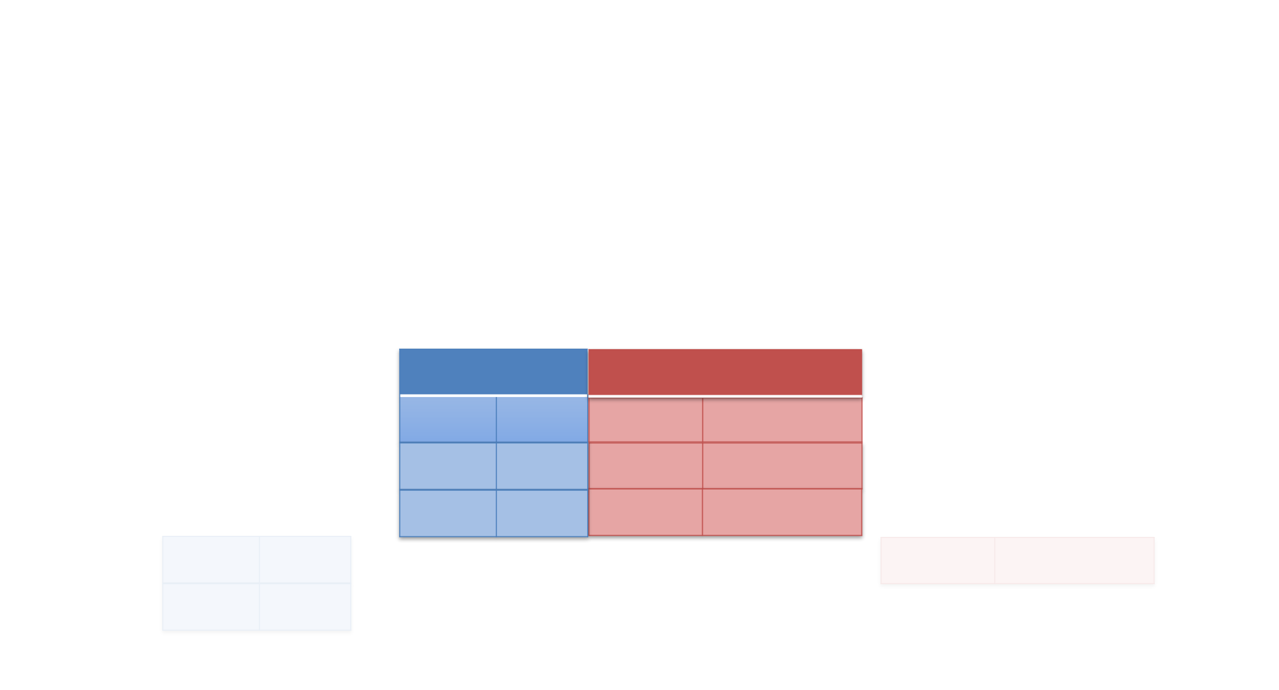
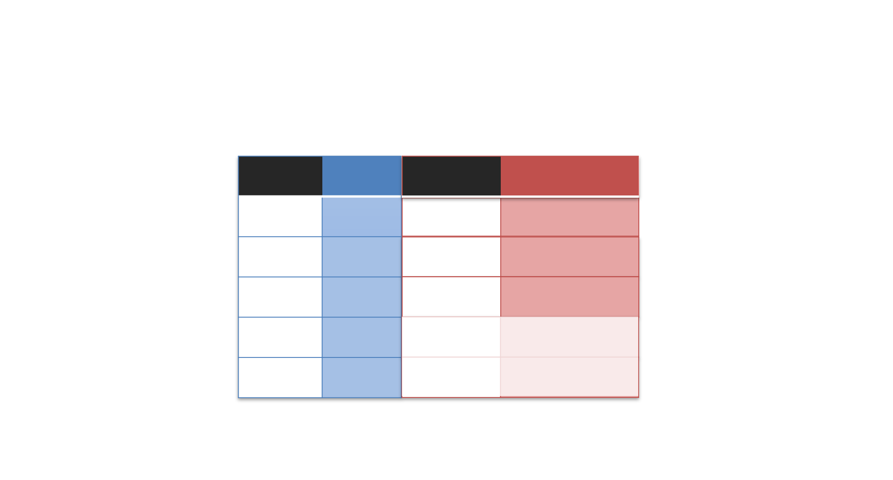
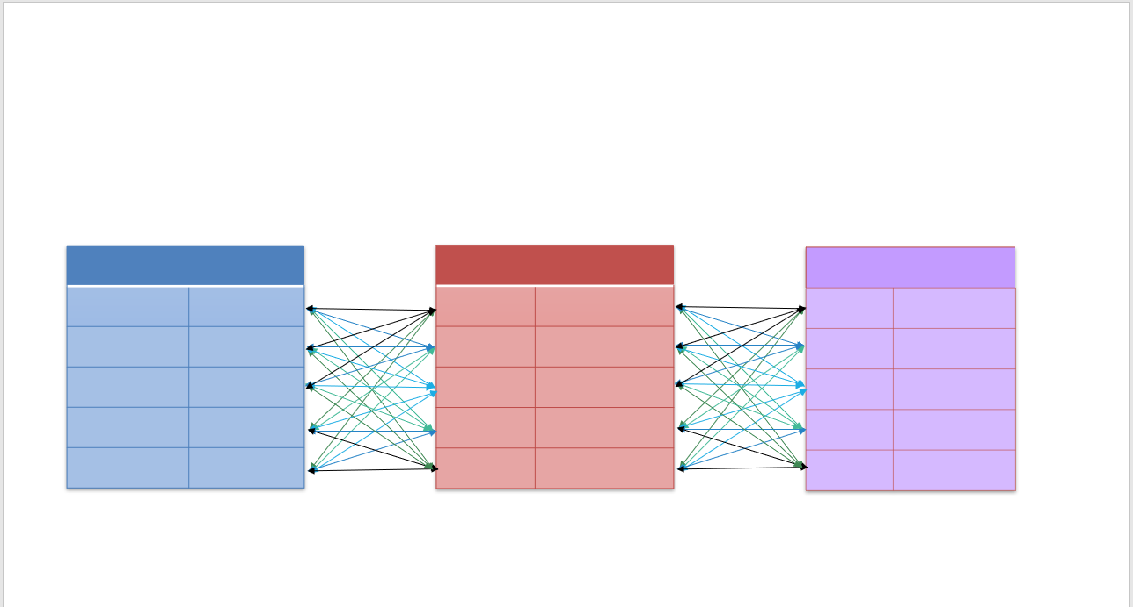
The many mishaps of merging data
Null Values
Missing Data
Row Duplication

Slide 51
Meeting the merging data morass
1. Know your data
Whats the difference between an order, a test, and a result?
2. Check your assumptions
Count(), distinct(), semi_join() and anti_join()
3. Make sure you're asking the right question
…

Slide 52
HPI:
You, the hematology laboratory director, is listening in on Hematology Grand Rounds while quietly shopping on Amazon.
During a discussion about TTP the Hematology Division Chief asks you if you knew what diagnoses have been applied to patients who have schistocytes on the blood smear?

Slide 53
What else?
Join two tables using multiple columns
Join a table to itself

Slide 54
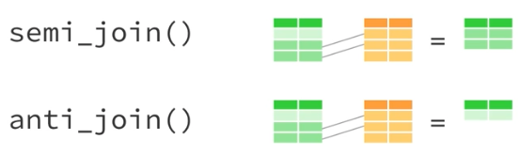
Filtering Joins!

Slide 55
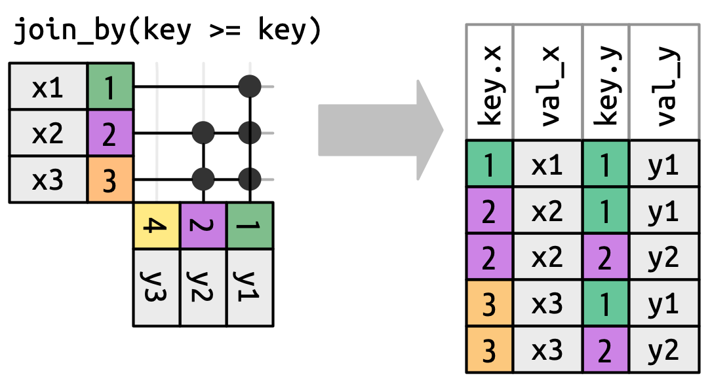
Non-equi Joins!

Slide 56

Fuzzyjoins!
Regex
String Distance
Geographic Distance
Genomic Distance

Slide 57
Thank you!

